Slide 1
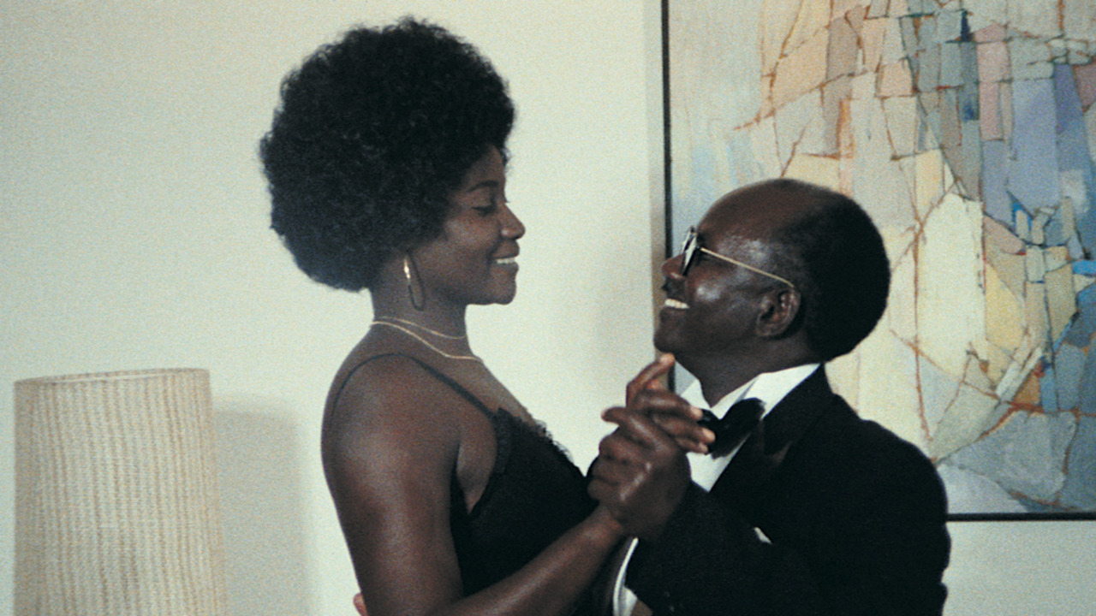
Class 7
Dancing in circles towards a changing road

Slide 2

State of the Nation films: work of fiction that reflects, satirize or comments on the society in which it is written
Third cinema as State of the Nation films

Slide 3
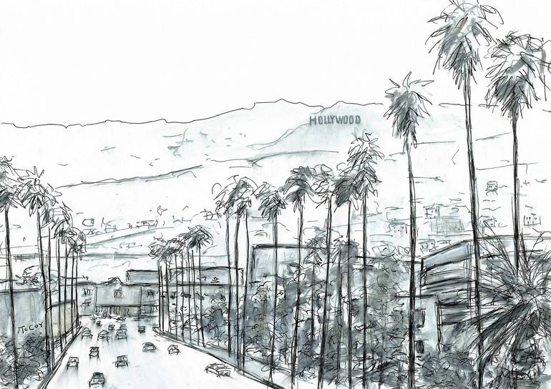
First cinema
- Studio System and Star System
- Idealization, pleasurability, identification
- IRM narrative: cohesion, invisibility, continuity
- Standardized technology: 35mm camera, 24fps,
- Satisfies the cultural needs of a specific ideology: capitalism

Slide 4

Second cinema
- An alternative to the first
- Independent industry and exhibition circuits
- Freedom and authorship of the filmmaker
- New narratives, more in touch with local societies
- It has reached a point where it’s too culturally exclusive, rigid and ignores the masses

Slide 5

- Third World does not necesarilly refer to poor in resources, non-industrialized or non-White, but of those under the conditions of a economic domination (colonized, decolonized and “minorities”)
Third cinema as State of the Nation films
Third cinema

Slide 6
Third cinema. Reflect on national issues at three levels:
- Content: neocolonialism and post-colonialism
- Industry: lack of resources as their weapon
- Aesthetics: unpleasant, “poor cinema”, “ugliness”.
Third cinema as State of the Nation films

Slide 7

So, emancipating themselves with a cinema of subversion, with its own new methods and models.
In other words, to give expression to national themes in a national style.
Third cinema as State of the Nation films

Slide 8
What catches our attention here?
Let’s take a view on the first sequence…

Slide 9

What’s the film about? Why the main character? or, how is “Xala” a State of the Nation film?

Slide 10

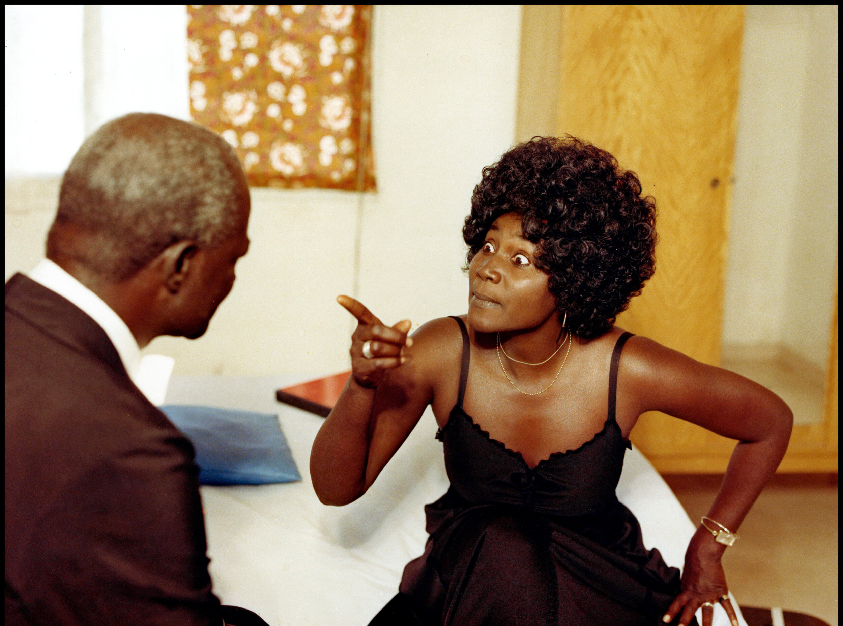
What’s the role of women in the film?
Do we see a uniform society or different subcultures and customs?

Slide 11
What other elements of the Third Cinema can be seen? Think of aesthetics and offscreen landscape
How is the film NOT conventionally enjoyable? Brecht and the “alienation effect”

Slide 12

Seminars
For next class…
End of unit on nationalism
The Motorcyle Diaries (Walter Salles, 2004)
Mette Hjort, “On the Plurality of Cinematic Transnationalism”

